Slide 1


AI Ecosystem
Understanding AI Market Landscape, Building Team, Business Value & Projects Overview
Himanshu Ramchandani
Microsoft MVP

Slide 2
Table of Contents
AI market growth and its relevance to your industries.
Business opportunities: Efficiency, cost savings, and competitive edge.
AI evolution: From neurons to neural networks, RNNs, CNNs, LSTMs, transformers, and LLMs.
How do we test the application effectiveness?
Limitations of LLMs and need for augmenting them like Fine tuning, RAG etc
LLM Evolution to Agents and Agentic AI solutions (Intro only)

Slide 3
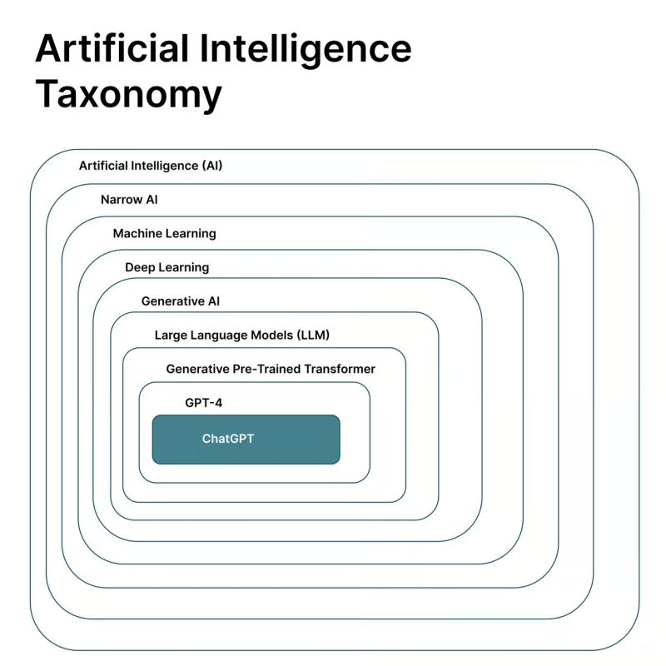

Slide 4
Himanshu Ramchandani
AI Landscape 2025
2 major challenges businesses face with AI right now:
estimating and demonstrating AI value
lack of talent/skills

Slide 5
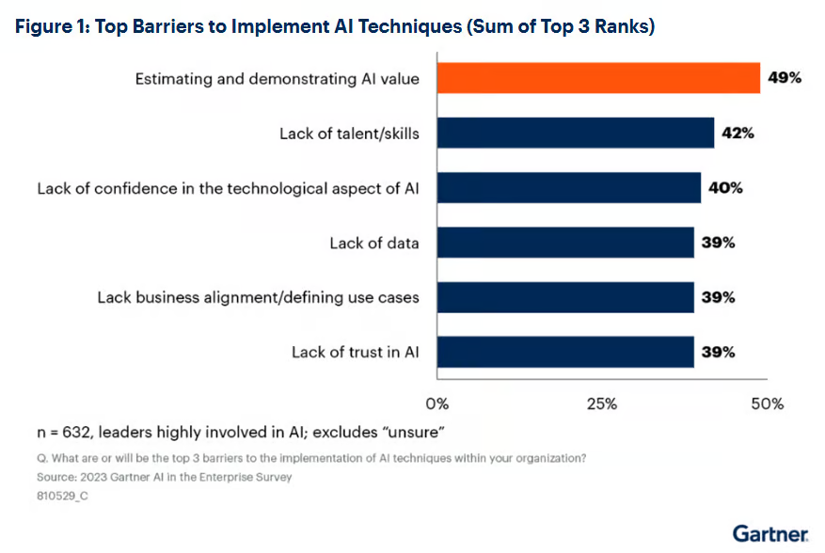

Slide 6
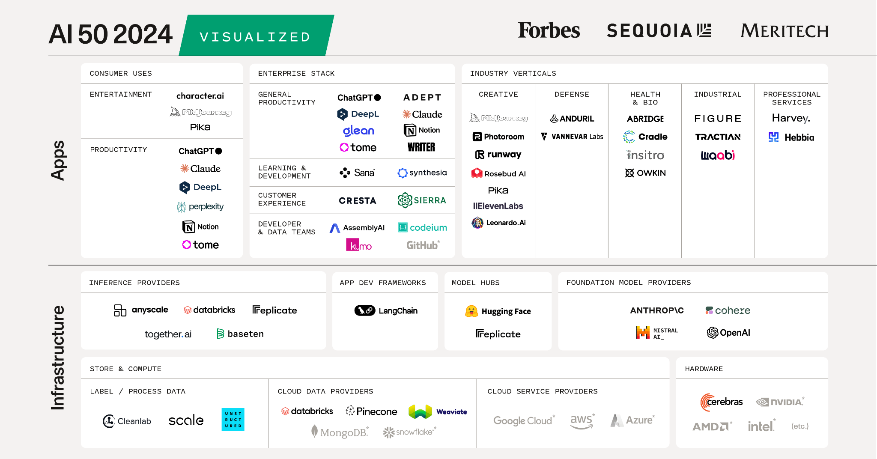

Slide 7
Himanshu Ramchandani
AI market growth and its relevance to your industries.
Valued at USD 233.46 billion in 2024 and
Projected to reach USD 1,771.62 billion by 2032
The AI chips market has quadrupled in value since 2021 ($10.8 billion), reaching $44.3 billion in 2025.

Slide 8
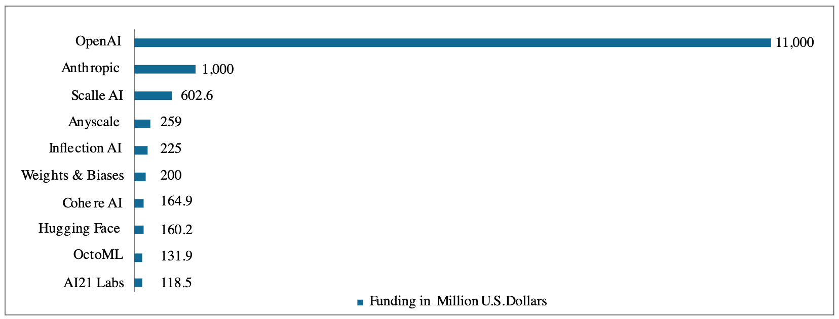
Capital Raised by AI Startups in 2023

Slide 9
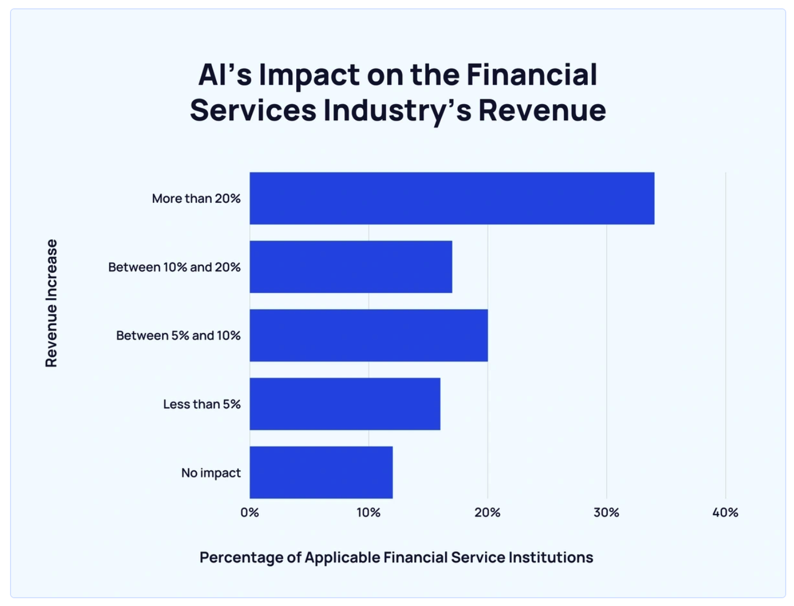

Slide 10
Himanshu Ramchandani
Applications by Industry
In manufacturing, AI systems optimize production lines, predict equipment failures before they occur, and significantly improve quality control processes
Financial institutions deploy AI systems for fraud detection, risk management, and investment advisory services

Slide 11
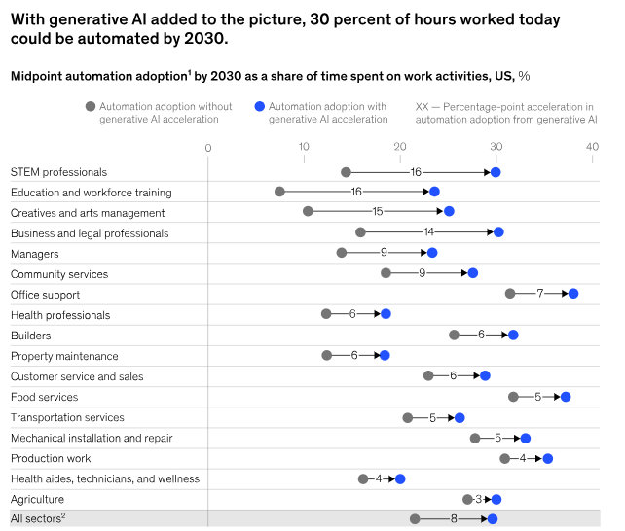

Slide 12
Himanshu Ramchandani
Business opportunities
Efficiency, cost savings, and competitive edge.
Automated 40 operations daily, saving 40 hours monthly, showcasing efficiency gains (StepWise)

Slide 13
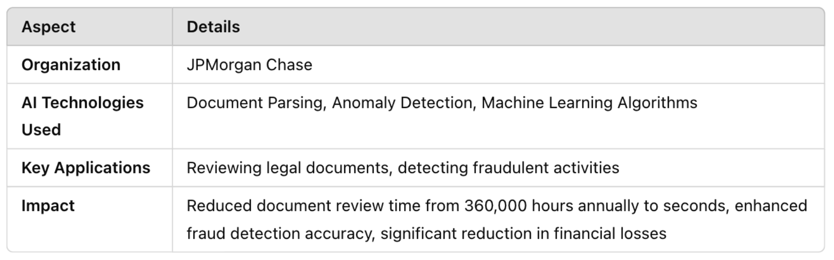
JPMorgen Chase in Finance

Slide 14
Himanshu Ramchandani
AI Evolution
From neurons to neural networks, RNNs, CNNs, LSTMs, transformers, and LLMs.

Slide 15
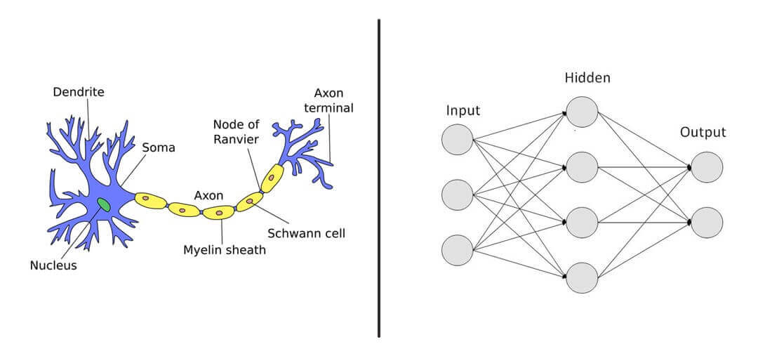
Neuron

Slide 16
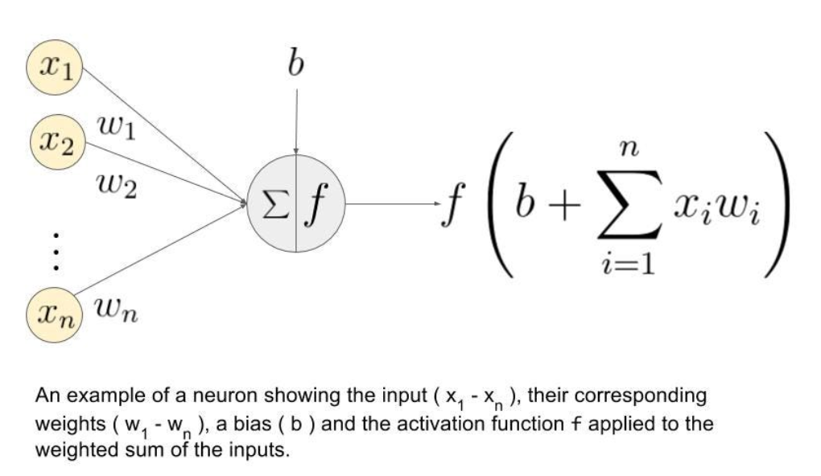
Neural Networks

Slide 17
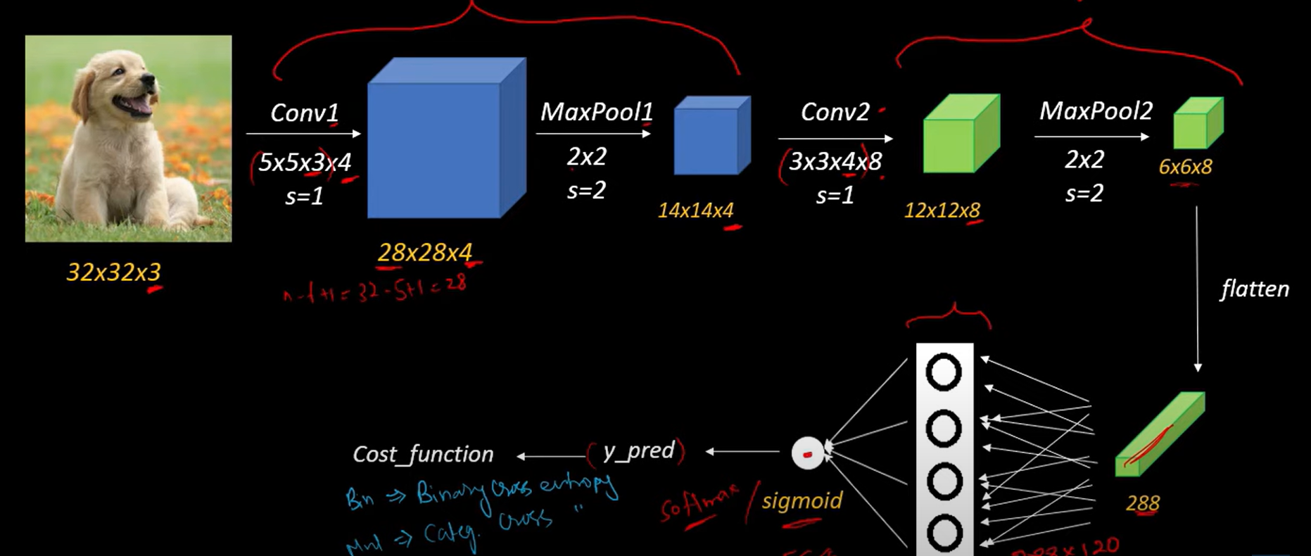
CNN (Convolutional Neural Network)

Slide 18
Attention Mechanism
“Himanshu is an AI consultant. He is going to solve your problems.“

Slide 19
RNN (Recurrent Neural Network)

Slide 20
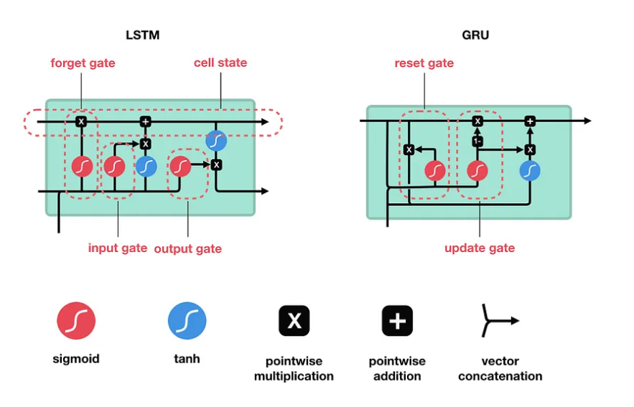
LSTM (Long Short Term Memory)

Slide 21
What exactly is GPT?
Generative
Pre-Trained
Transformer

Slide 22

Transformers

Slide 23
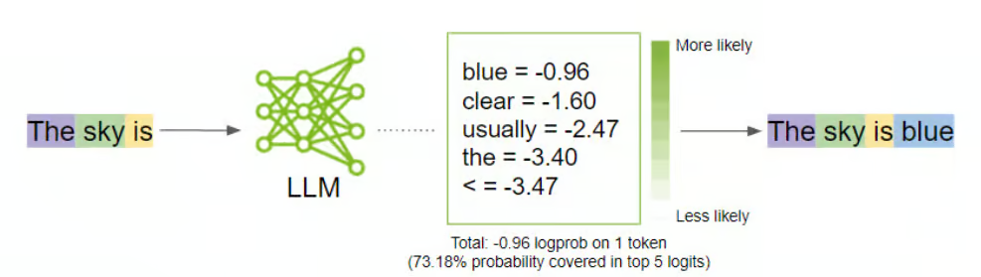
Large Language Models

Slide 24
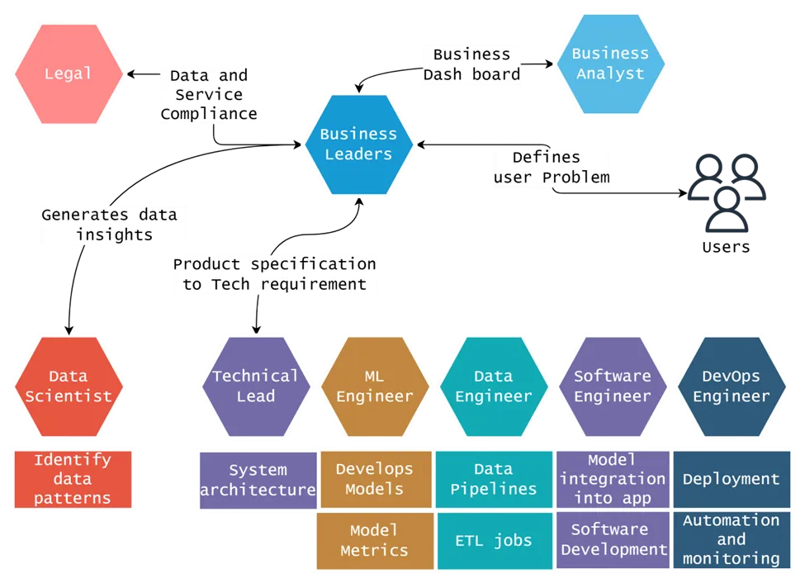

Slide 25
How do we test the application effectiveness?
Benchmark datasets (Humanity’s Last Exam)
OpenAI's Gym
TensorFlow's TF-Agents
Accuracy, response time, and resource utilization
Monitoring tools like Prometheus
HELM, CRFM, ARC, MLPerf, etc.

Slide 26
Limitations of LLMs
LLMs will always start fresh
LLMs do not improve with use
To get a better response, you must adapt to LLM
Solutions:
Fine-Tuning
RAG Approaches

Slide 27
LLM Evolution to Agents
From passive text generation to active task execution, decision-making, and process automation.
The Bot Factory (for creating new AI agents)
Creative Writers Workshop (supporting professional writers across genres)
Entrepreneur Support Center (providing business planning, strategy, and legal guidance)
Documentation & Marketing (specializing in technical documentation and marketing copy)
Industry-specific support centers for legal, immigration, and other specialized domains

Slide 28
Here’s How I can Help You
The Elite [AI Leadership Accelerator]
AI Engineer HQ for Professionals
AI Newsletter - the master
LinkedIn Content
AI Engineering & Consulting Services

Slide 29
Questions?
Thank You
Himanshu Ramchandani
Microsoft MVP

Slide 30
Resources
AI Engineer Roadmap: https://god-level-python.notion.site/AI-Engineer-HQ-b3c98407b4ab45819811db081ae9d102?pvs=4
AI Newsletter: https://newsletter.himanshuramchandani.co/
Linkedin: https://www.linkedin.com/in/hemansnation/
The Elite for AI Leaders: https://god-level-python.notion.site/The-Elite-AI-Leadership-Accelerator-1adffb33c49580488ae2c6179178a51b?pvs=4

